Slide 1

博士综合考评
姓名：陈博洋
导师：赵杰
二〇二零年九月

Slide 2
目录
专业基础知识学习情况
1
2
论文调研与工作思路
3
科研实际工作情况
4
4

Slide 3
1 专业基础知识学习情况
博士一年级，完成了《博士英语科技写作》、《中国马克思主义与当代》等课程的学习。以上课程考试全部通过，为后续的课题进展做好了基础知识上的准备。
自学专业理论知识
机器人学导论
欠驱动机器人学
ROS
C++、Python编程语言等
Drake
相关算法

Slide 4
目录
专业基础知识学习情况
1
2
论文调研及工作思路
3
科研实际工作情况
4

Slide 5
2 博士论文调研及工作思路
工作思路
正在进行

Slide 6
2 博士论文调研及工作思路
目前博士课题暂定为“仿鸵鸟双足机器人运动规划及优化控制研究”，主要研究内容为模仿鸵鸟双足高速灵活机动的能力，即实现一种既能使仿鸵鸟机器人实现高速机动，又能够灵活改变姿态的双足机器人控制方案。

Slide 7
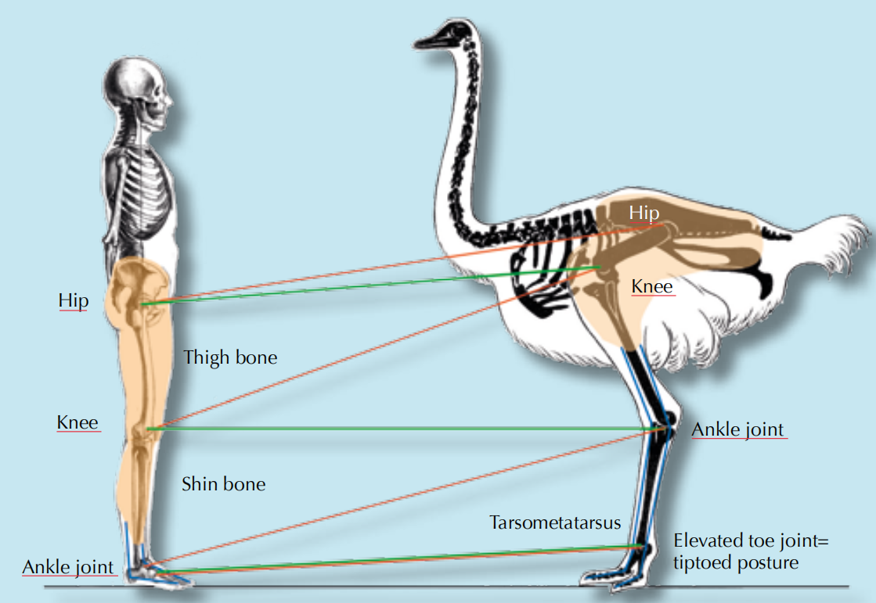
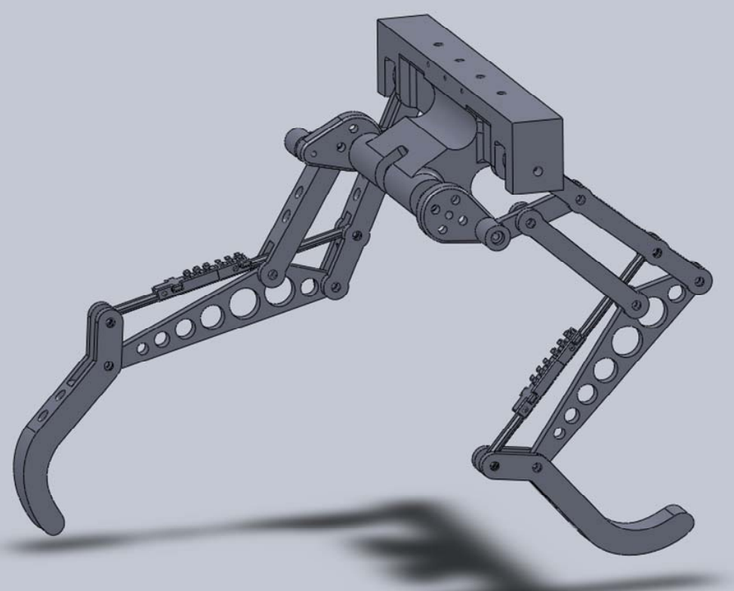
2 博士论文调研及工作思路
课题来源：“xxxxx”预研项目::双足部分
总体要求：重量轻、负载高，具有高稳定性、高鲁棒性和高速灵活机动能力双足机器人。

Slide 8
2 博士论文调研及工作思路
研究背景
与轮式或履带式机器人相比，腿式机器人具有与地面非连续接触的特点，具备更高的地形适应能力和更广应用范围；
足式机器人是腿式机器人的一个分支，随着计算能力和制造工艺的进步，成为学术界研究热点之一；
双足机器人与多足机器人相比，制造成本低，占地面积小，灵活性好，运动性能高，能够适应更加复杂的地形；且由于其运动方式与人或者动物的运动方式类似，更适合人机交互或人机协同作业；
从仿生学角度，双足由可分为仿人和仿动物两种，其中模仿动物以实现高速灵活机动方式，是双足领域的热点之一。

Slide 9
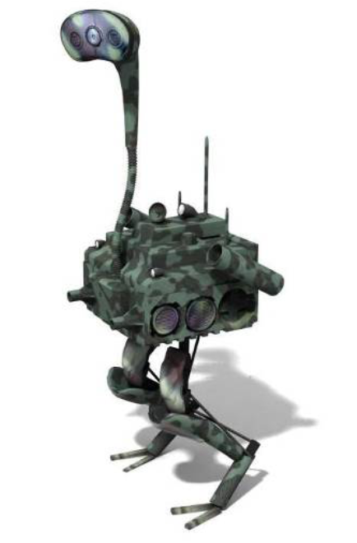
2 博士论文调研及工作思路
研究意义
双足机器人能够利用携带设备，在保持灵活机动的情况下完成作业，更加容易与人类进行协作，适应人类的生活工作环境，且对于具有危险性的任务场景，比如军事侦察，灾难救援，协同反恐等，使用双足机器人配合甚至代替人类完成任务是理想的工作形式，因此对具有高速灵活机动方式的仿生双足机器人的研究是具有重要理论价值和应用意义的。

Slide 10
2 博士论文调研及工作思路
国内外研究现状

Slide 11
2 博士论文调研及工作思路
国内外研究现状

Slide 12
2 博士论文调研及工作思路
鸵鸟运动方式特点
(Daley 2016; Duperret et al. 2016).

Slide 13
2 博士论文调研及工作思路
Q1：Why ostrich run so fast?/How to run fast like ostrich?
Question Formulation:
It is a compounded question about characteristics of speed, energy efficient, stability, robustness, or it is to say it is a result of optimized balance between the characteristics. The best answer is returned by nature(ostrich), so we need to replicate / approach to the ability to get our biped robot fast and agility as the first step.
Observations:
In terms of ostrich, a fundamental observation is
(1)kinematic and gravitational energy fluctuating in phase;
(2)some simplified models are capable to describing the data;
(3)leg stiffness is relatively with speed.
FastRunner: A Fast, Efficient and Robust Bipedal Robot.Concept and Planar Simulation.

Slide 14
2 博士论文调研及工作思路
Q1：Why ostrich run so fast?/How to run fast like ostrich?
Important insights of fundamental observations :
Due to the different constrains / muscles / actuations which will result in a hybrid system (different phase of gait cycle) with several modes and each mode is the optimal for specific duty;(Insight 1)
Less mass leg and less actuators can lead to underactuated principles;(Insight 2)
Passive dynamics and passive linkages;(Insight 3)
Mechanics can lead to self-stabilizing, i.e. stabilize the system in the presence of disturbances without sensing the disturbances or direct effect.(Insight 4)

Slide 15
2 博士论文调研及工作思路
Q2：What is the control in ostrich and the role of control in ostrich locomotion and our research?
An answer from Biology(The best answer is returned by nature(ostrich)):
Morphology biomechanics and Sensorimotor combination with neuromechanical control strategies.
An insight from Biological control:
Note:(we aim to make the robot fast and agile which imitate ostrich, a specific robot not real ostrich.)
Ostrich use several control strategies consistently across terrain contexts:
(1)Independent control of leg angular cycling and leg length actuation, which facilitates dynamic stability through simple control mechanisms;
Understanding the Agility of Running Birds: Sensorimotor and Mechanical Factors in Avian Bipedal Locomotion

Slide 16
2 博士论文调研及工作思路
Q2：What is the control in ostrich and the role of control in ostrich locomotion and our research?
(2) feedforward regulation of leg cycling rate, which tunes foot-contact timing to maintain consistent leg loading in uneven terrain (minimizing fall and injury risks);
(3) load-dependent muscle actuation, which rapidly adjusts stance push-off and stabilizes body mechanical energy;
(4) multi-step recovery strategies that allow body dynamics to transiently vary while tightly regulating leg loading to minimize risks of fall and injury.
Referring to: Neuromechanical control strategies.

Slide 17
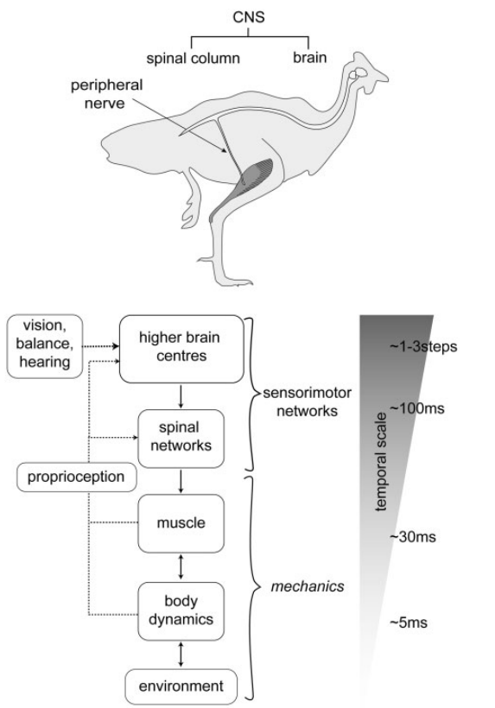
2 博士论文调研及工作思路
Q2：What is the control in ostrich and the role of control in ostrich locomotion and our research?
Neuromechanical control strategies:
Hierarchical organization of vertebrate neuromechanical control, like central, peripheral and mechanical mechanisms must be integrated over short and long timescales.The fastest responses occur in the periphery, through intrinsic
mechanics, intermediate responses occur through short latency spinal reflexes, and slower responses involve processing and planning in higher brain centers.

Slide 18
2 博士论文调研及工作思路
Q2：What is the control in ostrich and the role of control in ostrich locomotion and our research?
The role of control in ostrich locomotion: As we have the four Insights of fundemantal observations, we can found there are three insights are directly relative with Control component.

Slide 19
2 博士论文调研及工作思路
Q2：What is the control in ostrich and the role of control in ostrich locomotion and our research?
In terms of a robot like ostrich, it is really necessary to get a homologous control structures like the one in ostrich, or it is to say, the may be our first step to replicate the control structure from nature as the robot is replicating the nature.
In other words, we can also design our robot control like the neuromechanical control. And the role of control in our total reasearch is like the Neuromechanical control in ostrich.

Slide 20
2 博士论文调研及工作思路
Q3：What does neuromechanical control strategies do in ostrich locomotion?/the requirement of the control in our robot?
Animal researchers divide locomotions of birds into three categories: Drop, Step, Obstacle:
(Drop)According to the expoeriments by Blum and colleagues,animals manage the trade-off between terrain robustness and injury avoidance(leg retraction rate)in leg angular control when given ample practice negotiating a visible drop in terrain. And it prefer injury avoidance(low leg retraction) when abruptly drop.
stiffness/leg retraction?
Swing-Leg Trajectory of Running Guinea Fowl SuggestsTask-Level Priority of Force Regulation Rather thanDisturbance Rejection

Slide 21
2 博士论文调研及工作思路
Q3：What does neuromechanical control strategies do in ostrich locomotion/the requirement of the control in our robot?
In one word, the nature chooses a strategy that allowed body dynamics to transiently vary, with swing leg control optimized to maintain consistent leg loading in uneven terrain, which avoids both fall and injury conditions. In other words, if the robot plan to maintain a steady body dynamics, suggesting an increasing leg loading and risk of injury, little stride-to-stride variance in leg angular cycling rate in uneven terrain.

Slide 22
2 博士论文调研及工作思路
Q3：What does neuromechanical control strategies do in ostrich locomotion/the requirement of the control in our robot?
It also need to noticed that independent control of leg angular cycling and leg length actuation, which facilitates dynamic stability through simple control mechanisms, and the leg length rapidlly changed to alter leg posture and loading.
In one word, optimization of leg angular cycling rate as an effective control strategy for locomotion in uneven terrain allowing maintenance of consistent leg loading and high running speeds. And our robot also to design a feedback controller in response to the trade-off in uneven terrain.
Swing-Leg Trajectory of Running Guinea Fowl SuggestsTask-Level Priority of Force Regulation Rather thanDisturbance Rejection

Slide 23
2 博士论文调研及工作思路
Q3：What does neuromechanical control strategies do in ostrich locomotion/the requirement of the control in our robot?
(Obstacle)Experiments by Birn-Jeffery and colleagues revealed that birds exhibited independent control of leg angular cycling and leg length trajectory like drop. And take a three-step negotiation strategy which is most consistent with models optimized to regulate leg loading in uneven terrain not to maintain steady body dynamics.
In one word,Neuromechanical control strategy is regulation of leg cycling rate can be viewed as a combined feedforward plus‘preflexive’control strategy exploiting the intrinsic mechanical coupling between leg contact angle and leg loading and experimental evidence from both humans and birds running over a range of terrain perturbations are consistent with leg angular trajectory as a key target of neural control.
Birds achieve high robust_x0002_ness in uneven terrain through active control of landing conditions/Don’t break a leg: running birds from quail to ostrich prioritise leg safety and economy on un_x0002_even terrain

Slide 24
2 博士论文调研及工作思路
Q3：What does neuromechanical control strategies do in ostrich locomotion/the requirement of the control in our robot?
Requirement of control in our robot:
(1)leg contact angle and leg loading actuation are couplding
in control;
(2)leg angular trajectory as a key target of robot control and
relatively insensitive to perturbations and adjusted subtly
over longer time-scales;
(3)leg length actuation shows high stride-to-stride variance both
feedforward and feedback.
(4)As our robot imitates ostrich, we can use less leg stiffness
regulation as direct target for modular control, this point
need to check.
stiffness/leg retraction/leg length actuation?

Slide 25
2 博士论文调研及工作思路
Q4：What is neuromuscular mechanisms(muscle) and what is the effect compared with neuromechanical control?
Muscle activation and mechanical output is non-linear and dynamically variable. Earlier experiment muscle–tendon(spring for robot) is economic for state-locomotion(step). Due to the non-steady behaviors(drop and obstacle), when drops, muscle from shorten to stretched that acsorb energy of kinematic from gravitational potential energy and has a stabilizing effect on the body mechanical energy. When upsteps and obstacles, increased stretch and longer length during force development and increasing mechanical energy of the body, give the energy to the required upward kineticenergy and gravitational energy and stablize the Sagittal Plane kinetic energy.
Muscle force-length dynamics during level versus incline locomotion: a comparison of in vivo performance of two guinea fowl ankle extensors./ The role of intrinsic muscle mechanics in the neuromuscular control of stable running in the guinea fowl

Slide 26
2 博士论文调研及工作思路
Q4：What is neuromuscular mechanisms and what it do in ostrich locomotion compared with neuromechanical control?/effect of muscle in ostrich locomotion?
In one word, (neuromuscular mechanisms)muscle make locomotion more efficient in steady locomotion and has an effect of stablizing in non-steady locomotion.

Slide 27
2 博士论文调研及工作思路
Q4：What are the challenges in achieving fast agile bipedal locomotion like Ostrich?
ROBOT NEED:Robustness, Stability, Agility
Avoiding slip, fall, and injury requires precise regulation of foot-contact timing and leg-substrate interaction forces,
YET:
Inherent uncertainty due to terrain variability, sensorimotor noise, and sensing errors mean that the system dynamics cannot be perfectly sensed or predicted.
And the dynamic balance control is more complex than quadrupeds and other many-legged.
Specifically:
(1)Different hierarchy for reactions and controls remains unclear how these mechanisms are integrated over varying time scales to achieve robust, stable, and agile locomotion in natural terrain contexts;

Slide 28
2 博士论文调研及工作思路
Q4：What are the challenges in achieving fast agile bipedal locomotion like Ostrich?
(2)Passive-Dynamics the intrinsic mechanical response can be actively tuned by the selection of a specific muscle activation pattern from the possible.(the processes and timescales of such tuning between intrinsic mechanics and muscle activation patterns remain unclear)
(3)It remains less clear whether, and under what circumstances,leg stiffness serves as a direct target of control, even though, the limb morphology of birds can do better in minimizing the need for active regulation of leg stiffness than human. And birds exhibited a wider range of stable control solutions without adjusting leg stiffness.
(4)it remains unclear how sensory feedback is integrated with spinal neural circuits and higher brain centers to adjust locomotor control over short and long time-scales.

Slide 29
2 博士论文调研及工作思路
Question in robot control?
Delivered Research Points of Control:
Planning: Reason 3 is a mechanic problem and others directly relative to the control, i.e., Insight 1 and Insight 2 means how we implement or achieve an optimal motion planning in hybrid system or optimized the trajectory in different modes to get optimal gait cycle.
(2)Control: according to Reason 4, although mechanics can result the self-stability, but the accumulated error / disturbance / effect need to be correct through feedback control.(Robustness and low cost / memory long term methods to the accumulated error and the necessary trigger / guard event).

Slide 30
2 博士论文调研及工作思路
Question in robot control?
Delivered Research Points of Control:
(3)How different hierarchy intergrated of reactions and controls can over different time scales for different circumstances?
(4)Stiffness control in uneven terrain and intergrated to a point-to-point structure and is there any control strategy can counteract the effect like the birds.
(5)Passive can be choosen, how to choosen and when need to be choosen and how?

Slide 31
2 博士论文调研及工作思路
Question in robot control?
Delivered Research Points of Control:
Planning: Reason 3 is a mechanic problem and others directly relative to the control, i.e., Reason 1 and Reason 2 means how we implement or achieve an optimal motion planning in hybrid system or optimized the trajectory in different modes to get optimal gait cycle.
Control: according to Reason 4, although mechanics can result the self-stability, but the accumulated error / disturbance / effect need to be correct through feedback control.(Robustness and low cost / memory long term methods to the accumulated error and the necessary trigger / guard event).

Slide 32
2 博士论文调研及工作思路
研究目标
根据仿鸵鸟机器人运动特点，研究设计一套能够进行高速机动的，灵活主动调整姿态的，能够适应平坦/不平坦地形的，双足机器人控制方案。

Slide 33
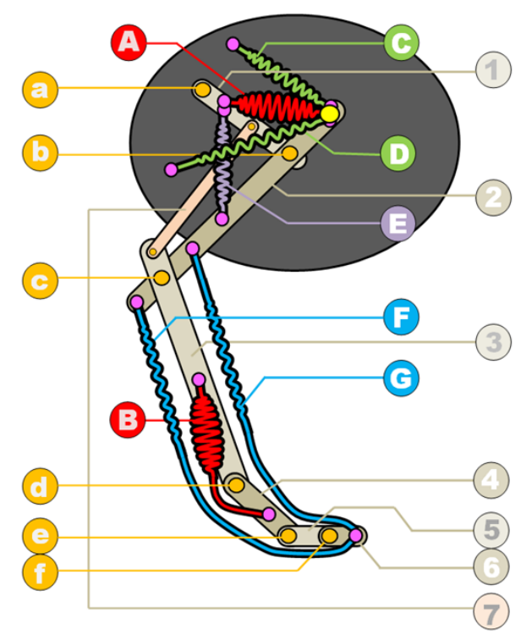
2 博士论文调研及工作思路
Abbr：muscles,bones,joints to springs,links,joints
How to get a simplified model and what is benefited?
It can get self-stability but it also need a local hip joint feedback and state-based control feedback for special maneuvers.
Special maneuvers include:
(1)recovering from large disturbances;
(2)stepping in a specifific location if required.
It will lead to a multi stages controller.

Slide 34
2 博士论文调研及工作思路
拟定的研究路线
考虑到机器人控制的理论结构特点，拟采用由下到上的研究方式，从轨迹追踪入手，利用已有的运动规划器、轨迹优化，和反馈控制器，先研究设计轨迹追踪控制器，在此基础上，逐步向上拓展，迭代的更新设计，最终实现满足鸵鸟运动要求的高稳定性、高鲁棒性、高灵活性的控制方案。

Slide 35
2 博士论文调研及工作思路
研究内容1：运动规划
根据仿鸵鸟机器人的动力学模型（SLIP等），研究设计控制各个关节
的运动规划器，求取机器人初始轨迹，其关键在于如何在线的保证机器人高速运动时的灵活性、动态稳定、鲁棒性要求。
已有方案及拟采用的技术路线

Slide 36
2 博士论文调研及工作思路
研究内容2：轨迹优化
根据运动规划生成的初始轨迹，研究设计一种轨迹优化器，通过优化
的手段进一步优化初始轨迹，求取满足运动特点与轨迹精度的最优轨迹。
已有方案及拟采用的技术路线

Slide 37
2 博士论文调研及工作思路
研究内容3：轨迹追踪
根据鸵鸟运动方式的特点，研究设计一种具有高鲁棒性的轨迹追踪
控制器。
已有方案及拟采用的技术路线

Slide 38
2 博士论文调研及工作思路
研究内容4：反馈控制
由于高速运动一定会存在较大的扰动和偏差，尤其是受到地形的干
扰时，研究设计一种能够主动弥补偏差的反馈机制。
已有方案及拟采用的技术路线
目前已有的反馈控制主要是针对模块内的偏差，尤其是在基于优化的反馈控制器中，如 QP。
通过实验验证已有的反馈控制器性能，研究控制器层的反馈控制在高速机动时的执行效率；
研究在偏差过大时，通过修正轨迹优化的优化轨迹，增强系统稳定性；
研究运动规划与轨迹优化参与整体反馈控制的效能，自底向上的层级反馈控制机制，以实现仿鸵鸟机器人的有限时间稳定性和高度鲁棒性。

Slide 39
目录
专业基础知识学习情况
1
2
论文调研及工作思路
3
科研实际工作情况
4

Slide 40
3 科研实际工作情况
根据工作思路与研究路线，目前已完成的工作有：
1. 仿生鸵鸟运动方式特点的调研，机器人模型设计的调研；
2. 基于Drake、ROS Melodic和Gazebo的实验平台的搭建，并通过手推车杆模型验证实验平台；

Slide 41
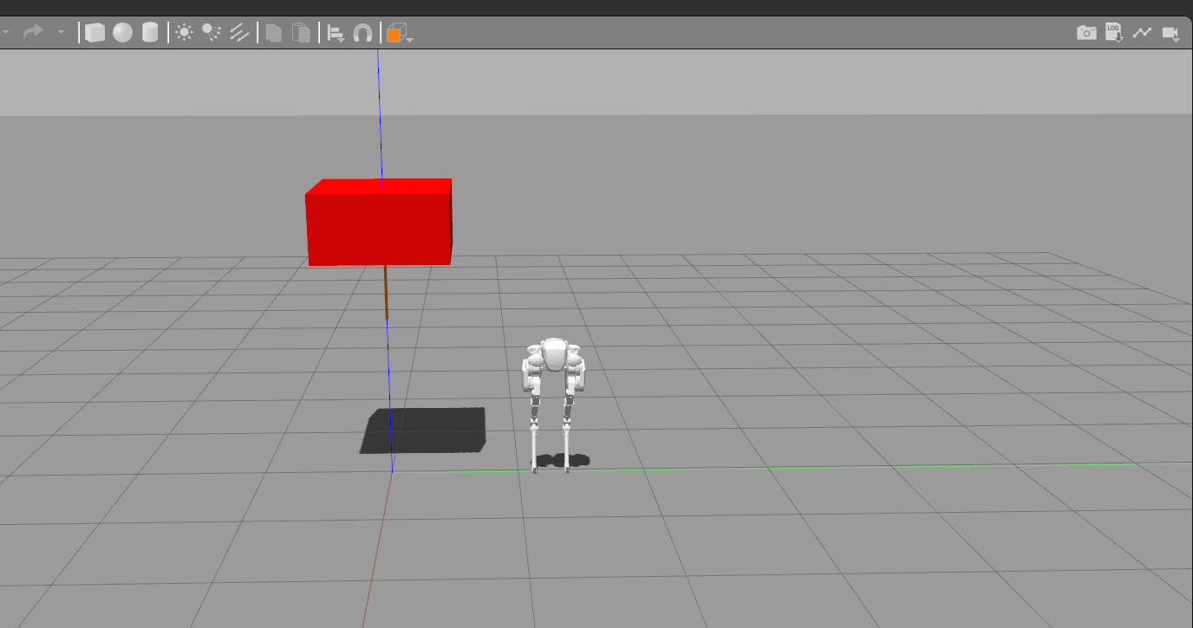
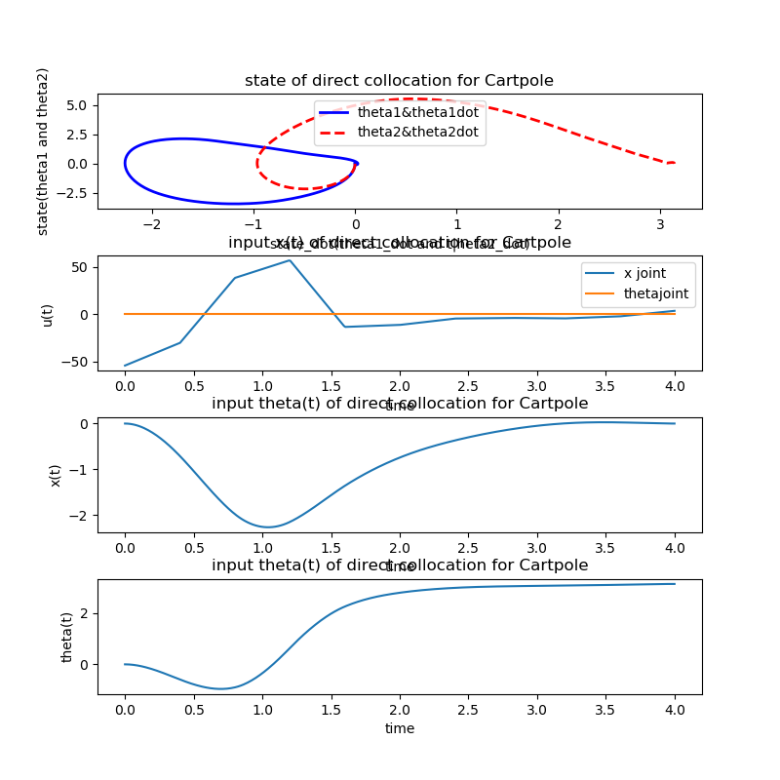
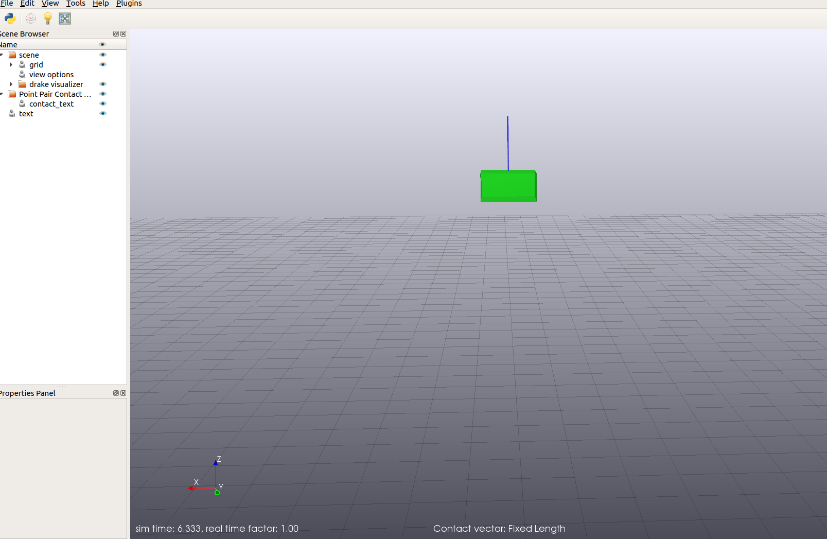
3 科研实际工作情况
根据工作思路与研究路线，目前已完成的工作有：

Slide 42
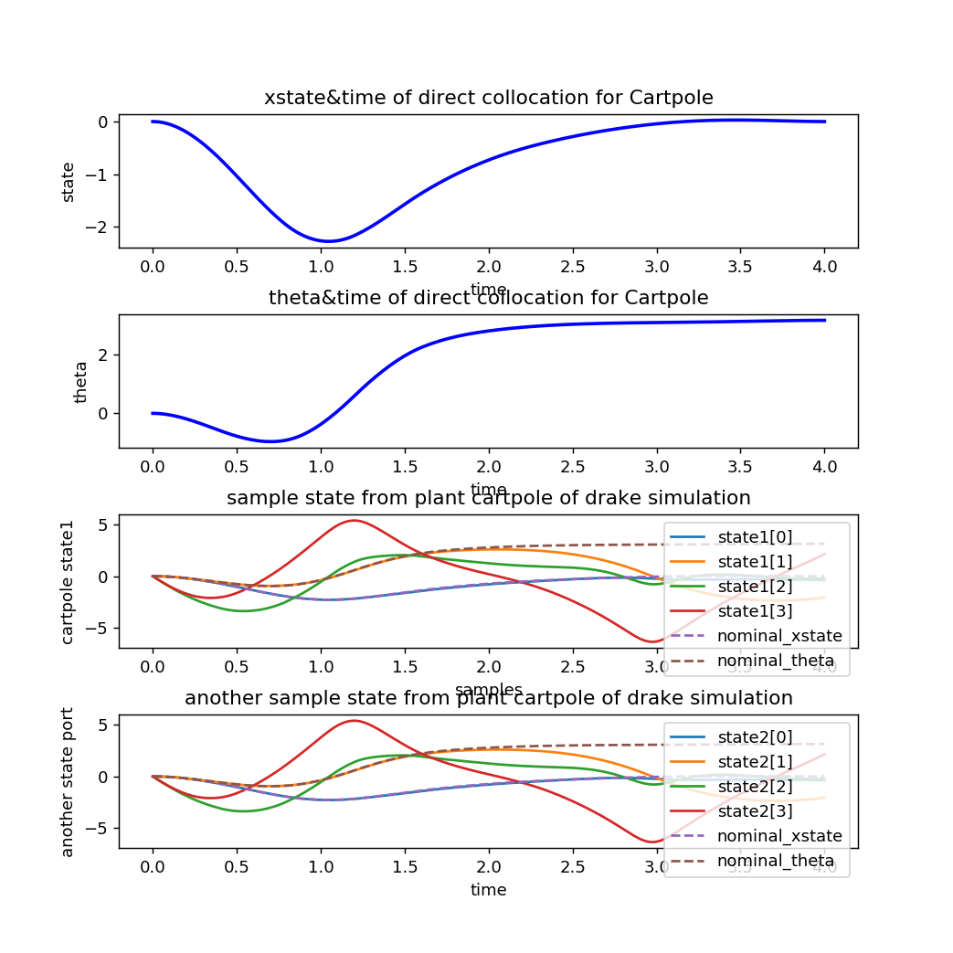
3 科研实际工作情况
根据工作思路与研究路线，目前已完成的工作有：
3. 利用该实验平台进行了轨迹优化算法Direct Collocation和PID控制器验证实验，DirectCollocation和LQR最优控制器验证实验；

Slide 43
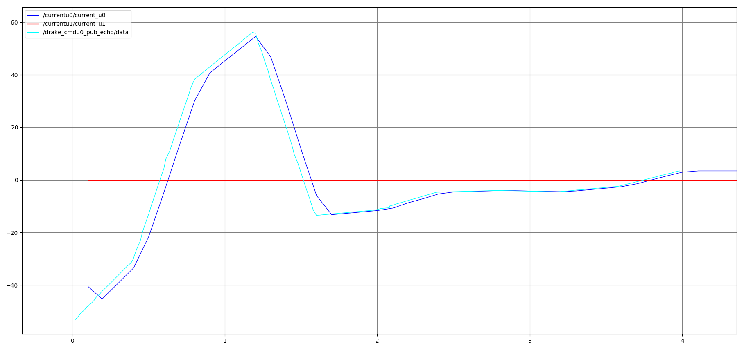
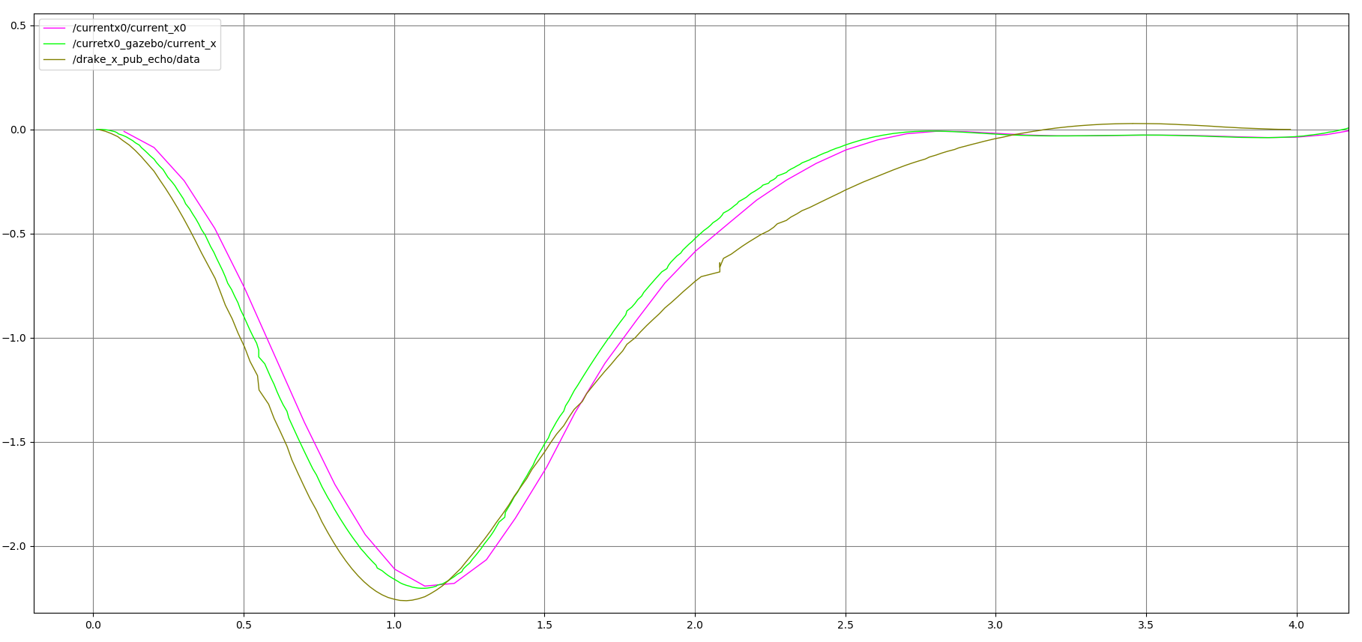
3 科研实际工作情况
根据工作思路与研究路线，目前已完成的工作有：

Slide 44
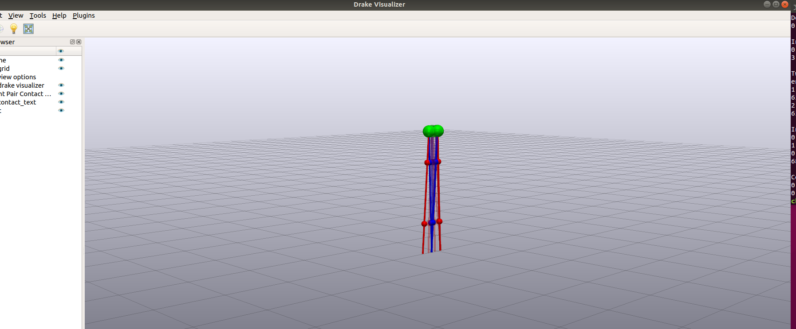
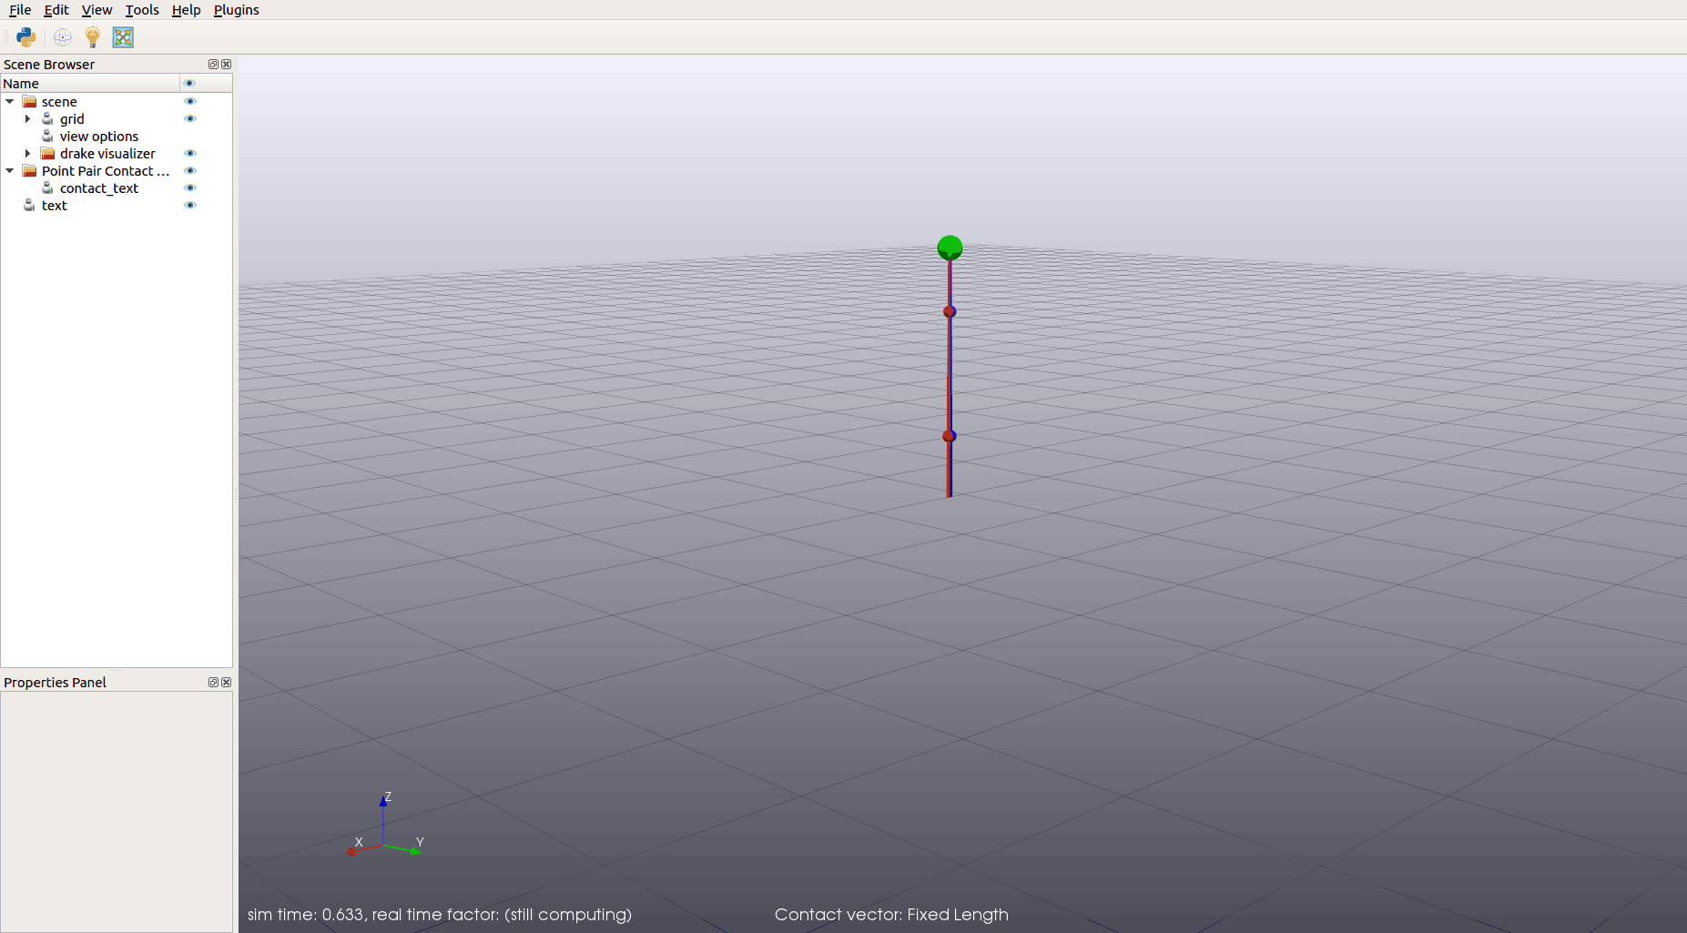
3 科研实际工作情况
根据工作思路与研究路线，目前已完成的工作有：
4. 利用该实验平台完成了基于优化的运动规划器DIRCON与Plannar Walker的验证实验；

Slide 45
3 科研实际工作情况
正在进行的工作：
正在进行以Cassie双足机器人为对象，以基于优化的DIRCON为运动规划器，结合轨迹优化算法Direct Collocation和最优控制器LQR、PID控制器的效能分析实验。

Slide 46
3 科研实际工作情况
参与的科研活动及成果：
1.“xxxxxx”预研项目调研和项目立项建议书的编写。
2.“xxxxxx”项目Ether-CAT等总线调研。
3.论文，SCI B. Chen, K. Liu and E. Belyaev, "An Efficient Hardware Implementation of Multialphabet Adaptive Arithmetic Encoder Based on Generalized Virtual Sliding Window," in IEEE Transactions on Very Large Scale Integration (VLSI) Systems, vol. 28, no. 5, pp. 1326-1330, May 2020, doi: 10.1109/TVLSI.2020.2966306.

Slide 47

谢谢！
请老师批评指正！

